Slide 1
Indexing – Part 2
B- Trees and B+ Trees
Dr. L.M. Jenila Livingston
VIT Chennai

Slide 2
k₁
k₂
k₃
. . .
k_{m-2}
k_{m-1}
T₀
T₁
T₂
T_{m-2}
T_{m-1}
key < k₁
k₁ < key < k₂
k₂ < key < k₃
k_{m-2} < key < k_{m-1}
key > k_{m-1}
Multi-way tree

Slide 3
Introduction
Disadvantage of traditional sparse and dense index files:
  Periodic reorganization is required.

Slide 4
B -Trees

Slide 5
What is a B-Tree?
B-tree is a specialized multiway tree designed especially for use on disk.
B-Tree consists of a root node, branch nodes and leaf nodes containing the indexed field values in the ending (or leaf) nodes of the tree.

Slide 6
B-tree
Definition
A balanced search tree in which every node has between m/2 and m children, where m>1 is a fixed integer.
‘m’ is the order / height of a tree, the maximum number of children of nodes in a B-tree.
The root may have as few as 2 children.
All non-leaf nodes except the root have at least
⎡m / 2⎤ children
All leaves are on the same level

Slide 7
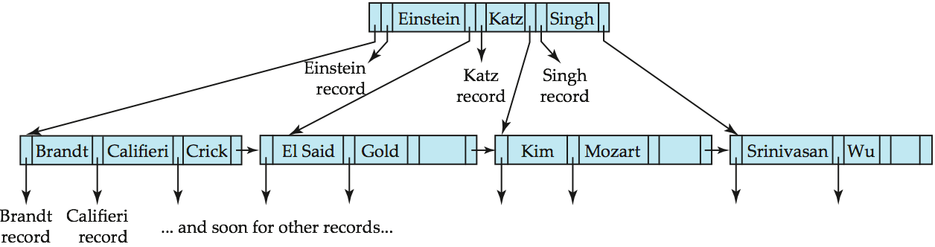
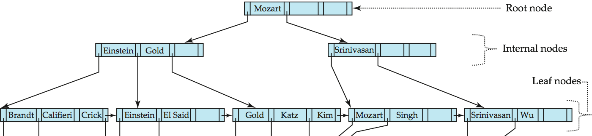
B-Tree and B+ tree Index File Example
B-tree and corresponding B+-tree on the same data:
B-tree (above) and B+-tree (below) on same data

Slide 8
B trees Vs B+ trees
B trees | B+ trees
All internal and leaf nodes have data pointers | Only leaf nodes have data pointers
Since all keys are not available at leaf, search often takes more time. | All keys are at leaf nodes, hence search is faster and accurate..
No redundant search keys are present.. | Redundant search keys may be present.
Insertion takes more time and it is not predictable sometimes. | Insertion is easier and the results are always the same.
Deletion of internal node is very complex and tree has to undergo lot of transformations. | Deletion of any node is easy because all node are found at leaf.
Leaf nodes are not stored as structural linked list. | Leaf nodes are stored as structural linked list.

Slide 9
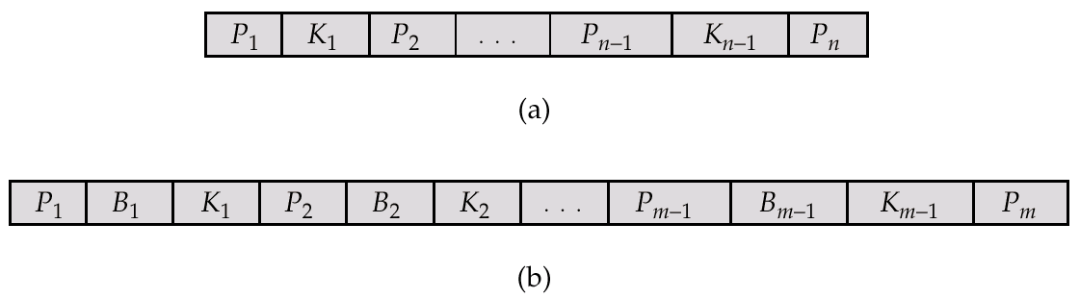
B-Tree Index Files
A B-tree is like a B+ tree, but only allows search-key values to appear once.
Search keys in non-leaf nodes appear nowhere else in a B-tree; an additional pointer for each search key in a non-leaf node is included.
Generalized B-tree leaf node:
Non-leaf node pointers B_{i} are the bucket or file record pointers.

Slide 10
B-Tree Index Files, Cont.
Advantages of B-Tree indices:
  May use fewer tree nodes than a corresponding B⁺-Tree.
  Sometimes possible to find search-key values before a reaching leaf node.
Disadvantages of B-Tree indices:
  Only a “small fraction” of all search-key values are actually found early.
  Non-leaf nodes contain more data, so fan-out is reduced, and thus, B-Trees typically have greater depth than corresponding B⁺-Tree.
  Insertion and deletion more complicated than in B⁺-Trees.

Slide 11
B-Tree Insertion
B-tree starts with a single root node (which is also a leaf node) at level 0.
Once the root node is full with m – 1 search key values and when attempt to insert another entry in the tree, the root node splits into two nodes at level 1.
Only the middle value is kept in the root node, and the rest of the values are split evenly between the other two nodes.
When a nonroot node is full and a new entry is inserted into it, that node is split into two nodes at the same level, and the middle entry is moved to the parent node along with two pointers to the new split nodes.
If the parent node is full, it is also split.
Splitting can propagate all the way to the root node, creating a new level if the root is split.

Slide 12
B-Tree Deletion
If deletion of a value causes a node to be less than half full, it is combined with it neighboring nodes, and this can also propagate all the way to the root.
- Can reduce the number of tree levels.
*Shown by analysis and simulation that, after numerous random insertions and deletions on a B-tree, the nodes are approximately 69 percent full when the number of values in the tree stabilizes. If this happens , node splitting and combining will occur only rarely, so insertion and deletion become quite efficient.

Slide 13
Constructing a B-tree
Suppose we start with an empty B-tree and keys arrive in the following order:1 12 8 2 25 6 14 28 17 7 52 16 48 68 3 26 29 53 55 45
We want to construct a B-tree of order 5 (Maximum number of search keys=4)
The first four items go into the root:
To put the fifth item in the root would violate condition 5
Therefore, when 25 arrives, pick the middle key to make a new root
1
2
8
12

Slide 14
Constructing a B-tree
Add 25 to the tree
Exceeds Order. Promote middle and split.
1
2
8
12
25
1 12 8 2 25 6 14 28 17 7 52 16 48 68 3 26 29 53 55 45

Slide 15
Constructing a B-tree (contd.)
8
1
2
12
25
6, 14, 28 get added to the leaf nodes:
8
1 12 8 2 25 6 14 28 17 7 52 16 48 68 3 26 29 53 55 45
1
2
6
14
28
1
2
12
25

Slide 16
Constructing a B-tree (contd.)
Adding 17 to the right leaf node would over-fill it, so we take the middle key, promote it (to the root) and split the leaf
8
25
28
28
1
2
6
17
2
12
14
1 12 8 2 25 6 14 28 17 7 52 16 48 68 3 26 29 53 55 45
1 12 8 2 25 6 14 28 17 7 52 16 48 68 3 26 29 53 55 45

Slide 17
Constructing a B-tree (contd.)
7, 52, 16, 48 get added to the leaf nodes
8
17
7
25
28
48
1
2
6
12
14
52
1 12 8 2 25 6 14 28 17 7 52 16 48 68 3 26 29 53 55 45
16

Slide 18
Constructing a B-tree (contd.)
Adding 68 causes us to split the right most leaf, promoting 48 to the root
8
17
1 12 8 2 25 6 14 28 17 7 52 16 48 68 3 26 29 53 55 45
1
2
6
7
12
14
16
25
28
48
52
68

Slide 19
Constructing a B-tree (contd.)
Adding 3 causes us to split the left most leaf
8
17
48
7
2
6
7
12
14
16
1
3
25
28
52
68
1 12 8 2 25 6 14 28 17 7 52 16 48 68 3 26 29 53 55 45

Slide 20
Constructing a B-tree (contd.)
Add 26, 29, 53, 55 then go into the leaves
3
8
17
48
1
2
6
7
12
14
16
25
26
28
52
53
68
55
29
1 12 8 2 25 6 14 28 17 7 52 16 48 68 3 26 29 53 55 45

Slide 21
Constructing a B-tree (contd.)
Add 45 increases the trees level
Exceeds Order. Promote middle and split.
Exceeds Order. Promote middle and split.
3
8
17
48
1 12 8 2 25 6 14 28 17 7 52 16 48 68 3 26 29 53 55 45
1
2
6
7
12
14
16
25
26
28
29
45
52
53
55
68

Slide 22
Inserting into a B-Tree
Attempt to insert the new key into a leaf
If this would result in that leaf becoming too big, split the leaf into two, promoting the middle key to the leaf’s parent
If this would result in the parent becoming too big, split the parent into two, promoting the middle key
This strategy might have to be repeated all the way to the top
If necessary, the root is split in two and the middle key is promoted to a new root, making the tree one level higher

Slide 23
Exercise in Inserting a B-Tree
Insert the following keys to a 5-way B-tree:
3, 7, 9, 23, 45, 1, 5, 14, 25, 24, 13, 11, 8, 19, 4, 31, 35, 56

Slide 24
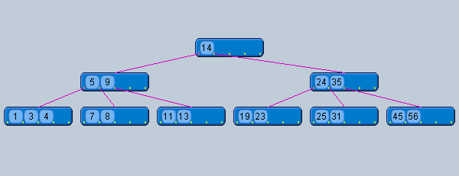
Answer to Exercise

Slide 25
Removal from a B-tree
During insertion, the key always goes into a leaf. For deletion we wish to remove from a leaf. There are four possible ways we can do this:
1 - If the key is in a leaf node, and removing it doesn’t cause that leaf node to have too few keys, then simply remove the key to be deleted.
2 - If the key is not in a leaf then it is guaranteed (by the nature of a B-tree) that its predecessor or successor will be in a leaf -- in this case can we delete the key and promote the predecessor or successor key to the non-leaf deleted key’s position.

Slide 26
Removal from a B-tree (2)
If (1) or (2) lead to a leaf node containing less than the minimum number of keys then we have to look at the siblings immediately adjacent to the leaf in question:
  3: if one of them has more than the min’ number of keys then we can promote one of its keys to the parent and take the parent key into our lacking leaf
  4: if neither of them has more than the min’ number of keys then the lacking leaf and one of its neighbours can be combined with their shared parent (the opposite of promoting a key) and the new leaf will have the correct number of keys; if this step leave the parent with too few keys then we repeat the process up to the root itself, if required

Slide 27
Deletion in B-Tree
There are four deletion cases:
  1. The leaf does not underflow.
  2. The leaf underflows and the adjacent right sibling has at least ⎡m / 2 ⎤ keys.
  perform a left key-rotation
  3.The leaf underflows and the adjacent left sibling has at least ⎡m / 2 ⎤ keys.
  perform a right key-rotation
  4. The leaf underflows and each adjacent sibling has ⎡m / 2⎤ - 1 keys.
  perform a merging

Slide 28
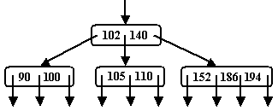
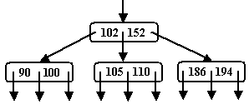
Deletion in B-Tree
Case1: The leaf does not underflow.
Example : B-tree of order 4
Delete 140

Slide 29
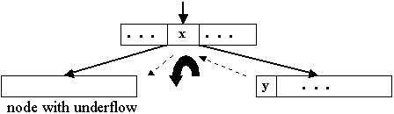
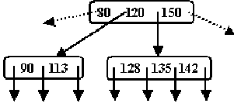
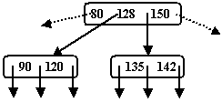
Deletion in B-Tree
Case2: The leaf underflows and the adjacent right sibling has at least ⎡m/2⎤ keys.
Example : B-tree of order 5
Perform a left key-rotation:
1. Move the parent key x that separates the siblings to the node with underflow
2. Move y, the minimum key in the right sibling, to where the key x was
3. Make the old left subtree of y to be the new right subtree of x.
Delete 113

Slide 30
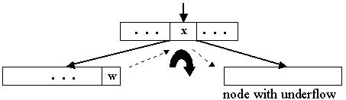
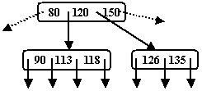
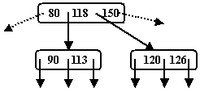
Deletion in B-Tree
Case 3: The leaf underflows and the adjacent left sibling has at least ⎡m / 2⎤ keys.
Example : B-tree of order 5
Perform a right key-rotation:
1. Move the parent key x that separates the siblings to the node with underflow
2. Move w, the maximum key in the left sibling, to where the key x was
3. Make the old right subtree of w to be the new left subtree of x
Delete 135

Slide 31
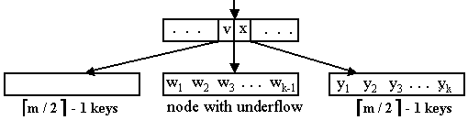
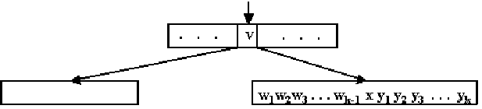
Deletion in B-Tree
Case 4:The leaf underflows and each adjacent sibling has ⎡m / 2⎤ - 1 keys
  If the parent of the merged node underflows, the merging process propagates upward. In the limit, a root with one key is deleted and the height decreases by one

Slide 32
Simple leaf deletion
Assuming a 5-way
B-Tree, as before...
12
29
52
2
7
9
15
22
31
43
56
69
72
Delete 2: Since there are enough
keys in the node, just delete it
Note when printed: this slide is animated

Slide 33
Simple non-leaf deletion
12
29
52
Delete 52
56
7
9
15
22
31
43
56
69
72
Borrow the predecessor
or (in this case) successor
Note when printed: this slide is animated

Slide 34
Too few keys in node and its siblings
12
29
56
Join back together
7
9
15
22
31
43
69
72
Too few keys!
Delete 72
Note when printed: this slide is animated

Slide 35
Too few keys in node and its siblings
12
29
7
9
15
22
31
43
56
69
Note when printed: this slide is animated

Slide 36
Enough siblings
12
29
Demote root key and
promote leaf key
7
9
15
22
31
43
56
69
Delete 22
Note when printed: this slide is animated

Slide 37
Enough siblings
12
31
7
9
15
29
43
56
69
Note when printed: this slide is animated

Slide 38
Exercise in Removal from a B-Tree
Given 5-way B-tree created by these data (last exercise):
3, 7, 9, 23, 45, 1, 5, 14, 25, 24, 13, 11, 8, 19, 4, 31, 35, 56
Add these further keys: 2, 6,12
Delete these keys: 4, 5, 7, 3, 14

Slide 39
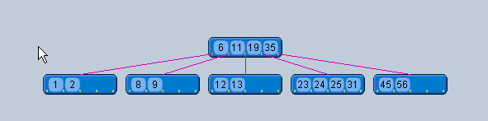
Answer to Exercise

Slide 40
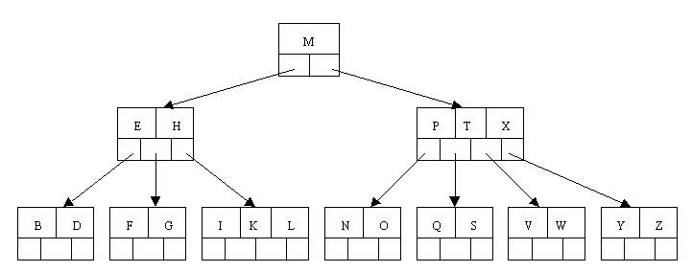
B-tree of Order 5 Example
All internal nodes have at least ceil(5 / 2) = ceil(2.5) = 3 children (and hence at least 2 keys), other then the root node.
The maximum number of children that a node can have is 5 (so that 4 is the maximum number of keys)
each leaf node must contain at least 2 keys

Slide 41

B-Tree Order 5 Insertion
Originally we have an empty B-tree of order 5
Want to insert C N G A H E K Q M F W L T Z D P R X Y S
Order 5 means that a node can have a maximum of 5 children and 4 keys
All nodes other than the root must have a minimum of 2 keys
The first 4 letters get inserted into the same node

Slide 42
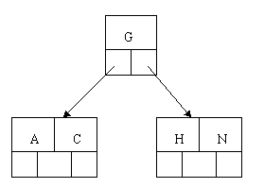
B-Tree Order 5 Insertion Cont.
When we try to insert the H, we find no room in this node, so we split it into 2 nodes, moving the median item G up into a new root node.

Slide 43
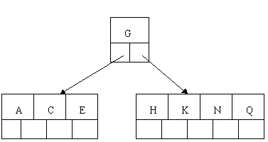
B-Tree Order 5 Insertion Cont.
Inserting E, K, and Q proceeds without requiring any splits

Slide 44
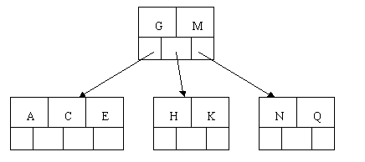
B-Tree Order 5 Insertion Cont.
Inserting M requires a split

Slide 45
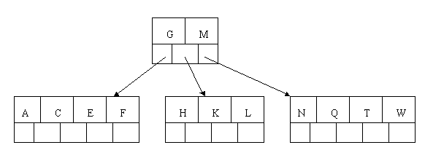
B-Tree Order 5 Insertion Cont.
The letters F, W, L, and T are then added without needing any split

Slide 46
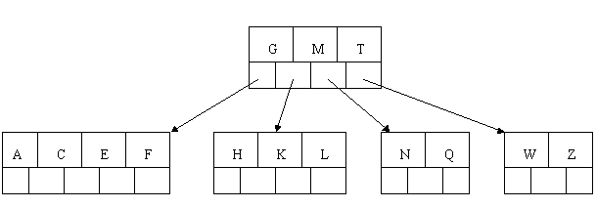
B-Tree Order 5 Insertion Cont.
When Z is added, the rightmost leaf must be split. The median item T is moved up into the parent node

Slide 47
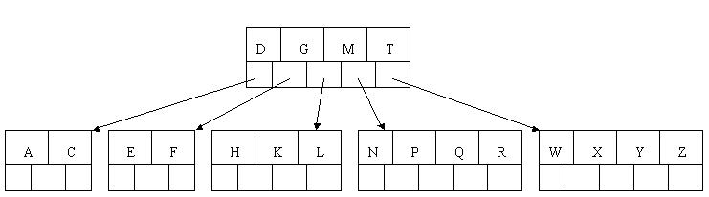
B-Tree Order 5 Insertion Cont.
The insertion of D causes the leftmost leaf to be split. D happens to be the median key and so is the one moved up into the parent node.
The letters P, R, X, and Y are then added without any need of splitting

Slide 48
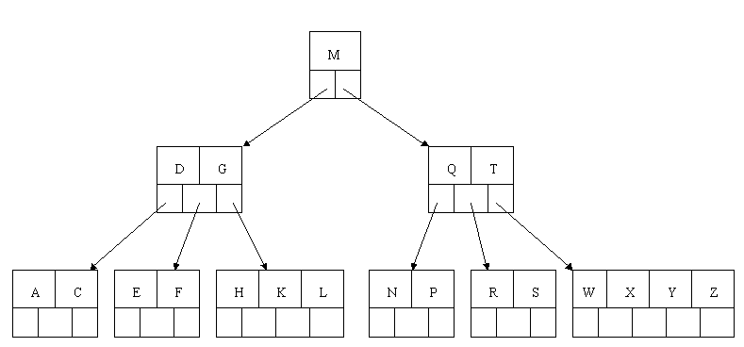
B-Tree Order 5 Insertion Cont.
Finally, when S is added, the node with N, P, Q, and R splits, sending the median Q up to the parent.
The parent node is full, so it splits, sending the median M up to form a new root node.

Slide 49
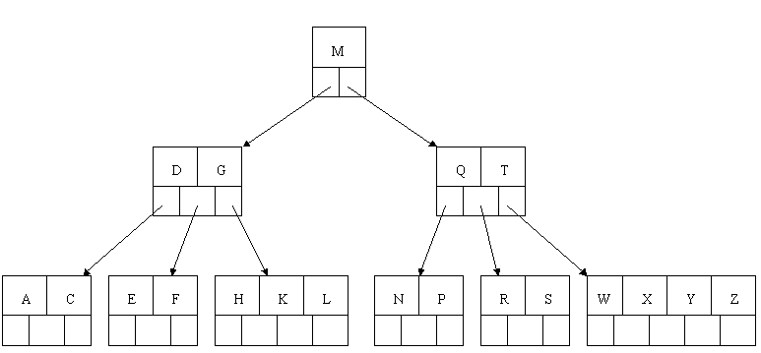
B-Tree Order 5 Deletion
Initial B-Tree

Slide 50
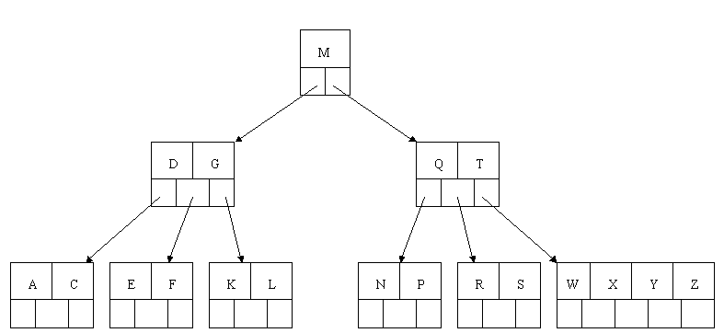
B-Tree Order 5 Deletion Cont.
Delete H
Since H is in a leaf and the leaf has more than the minimum number of keys, we just remove it.

Slide 51

B-Tree Order 5 Deletion Cont.
Delete T.
Since T is not in a leaf, we find its successor (the next item in ascending order), which happens to be W.
Move W up to replace the T. That way, what we really have to do is to delete W from the leaf .

Slide 52
B+ Trees

Slide 53
B⁺-Tree Index Files
B⁺-tree indices are a type of multi-level index.
Advantage of B⁺-tree index files:
  Automatically reorganizes itself with small, local, changes.
  Index reorganization is still required, but not as frequently*.
Disadvantage of B⁺-trees - extra time (insertion, deletion) and space overhead.
Advantages outweigh the disadvantages, and they are used extensively – the “gold standard” of index structures.

Slide 54
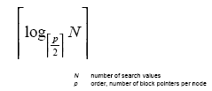
B+- Tree Characteristics Cont.
Very Fast Searching
Insertion and deletion are expensive.

Slide 55
B+- Tree Characteristics
Data records are only stored in the leaves.
Internal nodes store just keys.
Keys are used for directing a search to the proper leaf.
If a target key is less than a key in an internal node, then the pointer just to its left is followed.
If a target key is greater or equal to the key in the internal node, then the pointer to its right is followed.
B+ Tree combines features of ISAM (Indexed Sequential Access Method) and B Trees.

Slide 56
Formula n-order B+ tree with a height of h
Maximum number of keys is n^{h}
Minimum number of keys is 2(n / 2)^{h − 1}

Slide 57
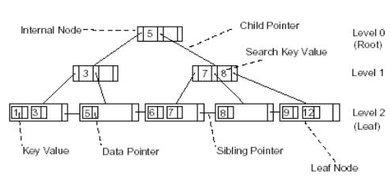
B+- Tree Structure

Slide 58

Example of B⁺-Tree

Slide 59
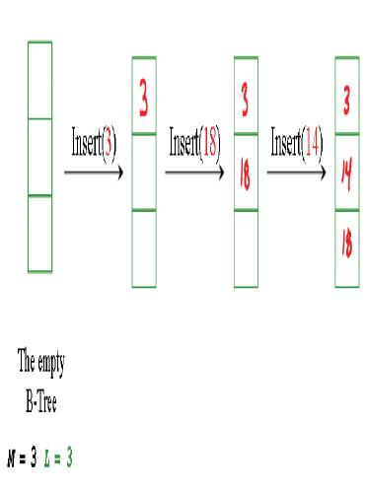
Building a B+ Tree with Insertions
-Example 1

Slide 60
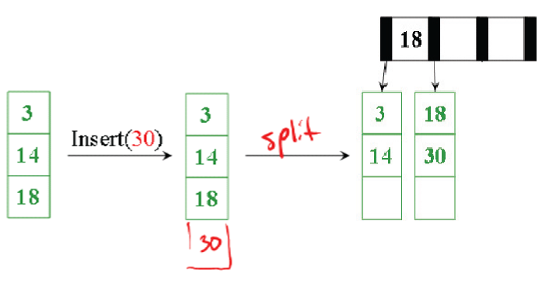
Building a B+ Tree with Insertions

Slide 61
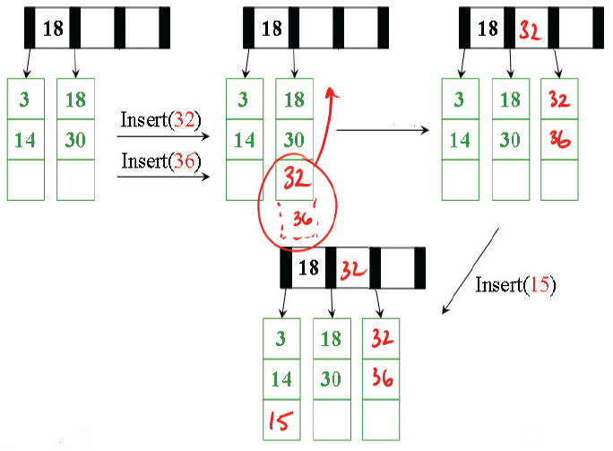
Building a B+ Tree with Insertions

Slide 62
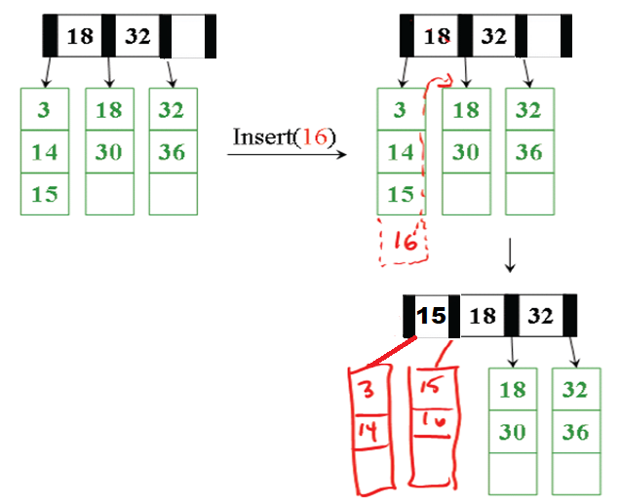
Building a B+ Tree with Insertions

Slide 63
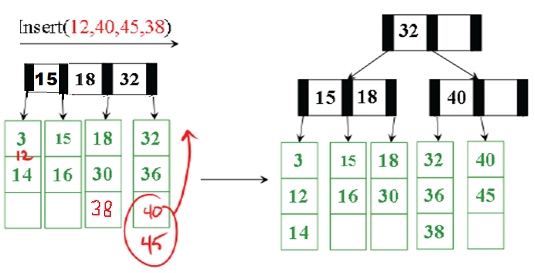
Building a B+ Tree with Insertions

Slide 64
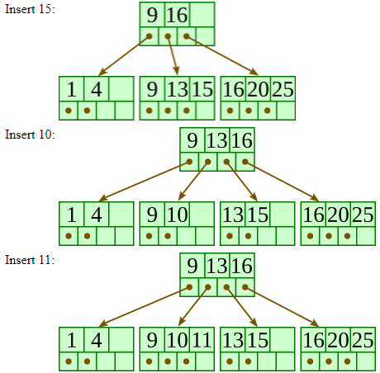
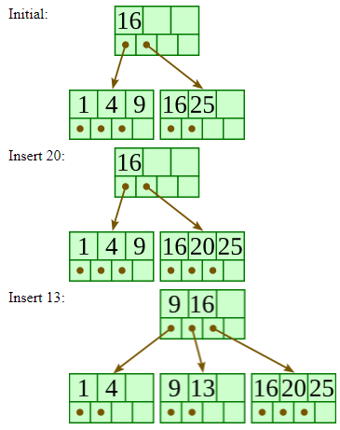
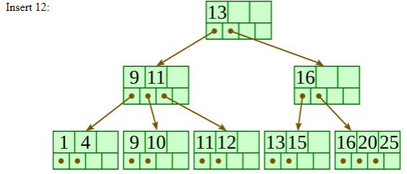
Example 2

Slide 65

Updates on B⁺-Trees: Insertion (Example 3)
Insert the following values into a B+ tree:
2 31 3 29 5 23 7 19 11 17

Slide 66

Updates on B⁺-Trees: Insertion (Cont.)
31 3 29 5 23 7 19 11 17

Slide 67

Updates on B⁺-Trees: Insertion (Cont.)
3 29 5 23 7 19 11 17

Slide 68

Updates on B⁺-Trees: Insertion (Cont.)
29 5 23 7 19 11 17

Slide 69
Updates on B⁺-Trees: Insertion (Cont.)
29 5 23 7 19 11 17

Slide 70


Updates on B⁺-Trees: Insertion (Cont.)
5 23 7 19 11 17

Slide 71
Updates on B⁺-Trees: Insertion (Cont.)
5 23 7 19 11 17
29

Slide 72



Updates on B⁺-Trees: Insertion (Cont.)
5 23 7 19 11 17

Slide 73

Updates on B⁺-Trees: Insertion (Cont.)
23 7 19 11 17

Slide 74
Updates on B⁺-Trees: Insertion (Cont.)
23 7 19 11 17

Slide 75

Updates on B⁺-Trees: Insertion (Cont.)
7 19 11 17

Slide 76


Updates on B⁺-Trees: Insertion (Cont.)
7 19 11 17
5

Slide 77

Updates on B⁺-Trees: Insertion (Cont.)
7 19 11 17

Slide 78

Updates on B⁺-Trees: Insertion (Cont.)
19 11 17

Slide 79

Updates on B⁺-Trees: Insertion (Cont.)
19 11 17

Slide 80


Updates on B⁺-Trees: Insertion (Cont.)
11 17

Slide 81




Updates on B⁺-Trees: Insertion (Cont.)
11 17
19

Slide 82

Updates on B⁺-Trees: Insertion (Cont.)
11 17

Slide 83

Updates on B⁺-Trees: Insertion (Cont.)
17

Slide 84
Updates on B⁺-Trees: Insertion (Cont.)
17

Slide 85

Updates on B⁺-Trees: Insertion (Cont.)

Slide 86
Updates on B⁺-Trees: Insertion (Cont.)
11

Slide 87
Updates on B⁺-Trees: Insertion (Cont.)
11

Slide 88





Updates on B⁺-Trees: Insertion (Cont.)
19

Slide 89

Updates on B⁺-Trees: Insertion (Cont.)

Slide 90
Updates on B⁺-Trees: Deletion
Find the data record to be deleted and remove it from the data file.
If the index is a secondary index on a non-candidate key field, then delete the corresponding pointer from the bucket.
If there are no more records with the deleted search key then remove the search-key and pointer from the appropriate leaf node in the index.
If the node is still at least half full, then nothing more needs to be done.
If the node has too few entries, i.e., if it is less than half full, then one of two things will happen:
  merging, or
  redistribution

Slide 91
Updates on B⁺-Trees: Deletion
Merging - if the entries in the node and a sibling fit into a single node, then the two are merged into one node:
  Insert all search-key values in the two nodes into a single node (the one on the left), and delete the other node.
  Delete the pair (K_{i–1}, P_{i}), where P_{i} is the pointer to the deleted node, from its parent, recursively using the above procedure.
Redistribution - otherwise redistribution occurs:
  Move a pointer and search-key value to the node from a sibling so that both have more than the minimum number of entries.
  Update the corresponding search-key value in the parent node.

Slide 92
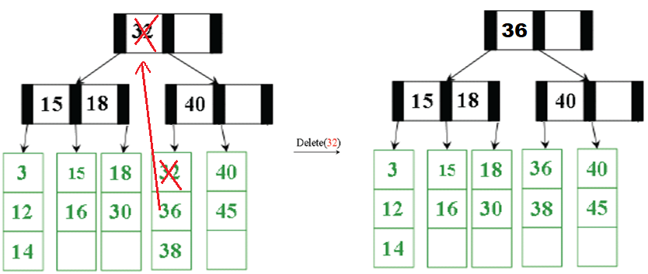
B+ Trees-Deletion

Slide 93
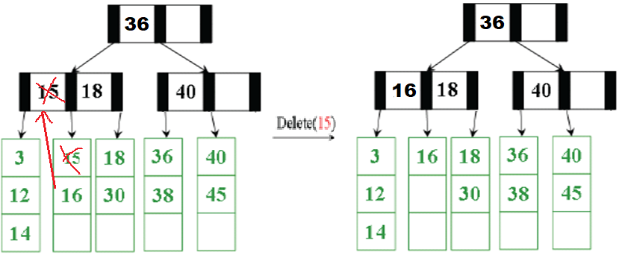
B+ Trees-Deletion

Slide 94
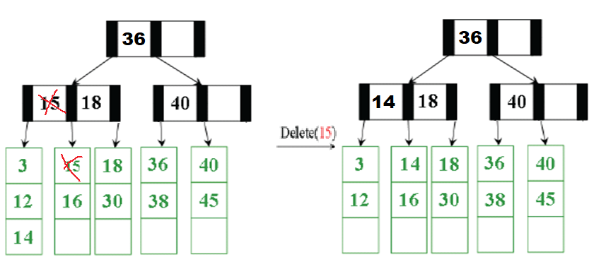
B+ Trees-Deletion: Distribution (Height Balancing)

Slide 95
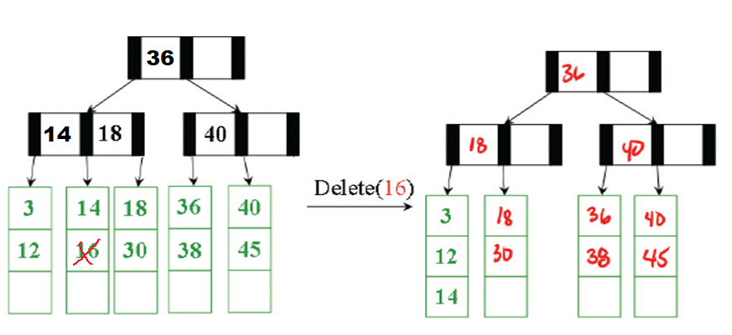
B+ Trees-Deletion: Merging

Slide 96
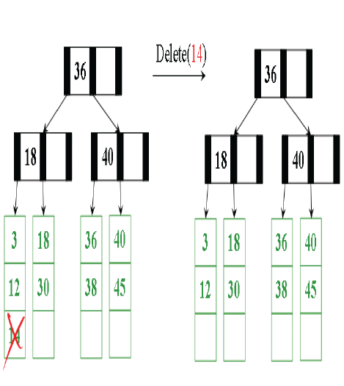


Slide 97
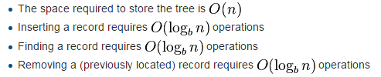
Complexity

Slide 98
Index Definition in SQL
Indices are created automatically by many DBMSs, e.g., on key attributes.
Indices can be created explicitely:
  create index <index-name> on <relation-name> (<attribute-list>)
  create index b-index on branch(branch-name)
Indices can be deleted:
  drop index <index-name>
Indices can also be used to enforce a candidate key constraint:
  create unique index <index-name>
  on <relation-name> (<attribute-list>)

Slide 99
References
https://www.geeksforgeeks.org/difference-between-b-tree-and-b-tree/
https://www.slideshare.net/anujmodi555/b-trees-in-data-structure

Slide 100
Thank You!

